Slide 1

PDAS Ca1(individual) an analysis of Singapore housing data
Justin wong juin hng (p2112646)

Slide 2
Objectives
In-depth walkthrough of the cleaning of given dataset(s)
Explain the purpose of dataset(s) analysis
Description of specific dataset(s) and related analyses
Analysis of insights gathered from dataset(s)
Credits

Slide 3
Data cleaning
raw_data = np.genfromtxt( './Datasets/(1) Price Range of HDB Flats Offered/price-range-of-hdb-flats-offered.csv', delimiter=',', names=True, dtype=[('financial_year', 'i8'), ('town', 'U20'), ('room_type', 'U8'), ('min_selling_price', 'i8'), ('max_selling_price', 'i8')]) # Array Declaration financial_year = [] town = [] room_type = [] min_selling_price = [] max_selling_price = [] for row in raw_data: financial_year.append(row[0]) town.append(row[1]) room_type.append(row[2]) min_selling_price.append(row[3]) max_selling_price.append(row[4]) mean_selling_price = np.mean(np.array([min_selling_price, max_selling_price]), axis=0) cleaned_data = { 'financial_year': np.array(financial_year), 'town': np.array(town), 'room_type': np.array(room_type), 'min_selling_price': np.array(min_selling_price), 'max_selling_price': np.array(max_selling_price), 'mean_selling_price': np.array(mean_selling_price) } labels = ['2 Rooms', '3 Rooms', '4 Rooms', '5 Rooms'] two_room_price = [] three_room_price = [] four_room_price = [] five_room_price = [] for i in range(len(cleaned_data['room_type'])): if room_type[i] == '2-room': two_room_price.append(mean_selling_price[i]) elif room_type[i] == '3-room': three_room_price.append(mean_selling_price[i]) elif room_type[i] == '4-room': four_room_price.append(mean_selling_price[i]) else: five_room_price.append(mean_selling_price[i])
Import
Import raw data from .CSV file
Assign
Assign names and labels
Declare
Declare arrays to store column-specific data
Store
Store column-specific data in arrays
Store
Store arrays into dictionary for ease of access
Add
Add additional logic to further cleanse and simplify dataset

Slide 4
Data cleaning
Import
Import raw data from .CSV file
Assign
Assign names and labels
Declare
Declare arrays to store column-specific data
Store
Store column-specific data in arrays
Store
Store arrays into dictionary for ease of access
Add
Add additional logic to further cleanse and simplify dataset
mpl.use('TkAgg') raw_data = np.genfromtxt('./Datasets/(4) Estimated Singapore Resident Population in HDB Flats/estimated-resident-population-in-hdb-flats-by-town.csv',delimiter=',',names=True, dtype=[('financial_year','i8'),('town_or_estate','U25'),('population','i8'),('region','U20')]) financial_year = [] region = [] population = [] for row in raw_data: financial_year.append(row[0]) region.append(row[3]) population.append(row[2]) cleaned_data ={ 'year':np.array(financial_year), 'region':np.array(region), 'population': np.array(population) } unique_label = np.unique(cleaned_data['region']) town_dict_1 = dict.fromkeys(unique_label, '') temp_value = [] for key,value in town_dict_1.items(): for i in range(len(population)): if region[i] == key: temp_value.append(population[i]) town_dict_1[key] = sum(temp_value) temp_value = []

Slide 5
Dictionary of dataset(s) used
Dataset Source | Variable Names
(1) Price Range of HDB Flats Offered/price-range-of-hdb-flats-offered.csv | financial_year town room_type min_selling_price max_selling_price
(2) Bookings for New Flats/bookings-for-new-flats.csv | financial_year no_of_units
(3) Flats Constructed/flats-constructed-by-housing-and-development-board-annual.csv | year flats_constructed
(4) Estimated Singapore Resident Population in HDB Flats/estimated-resident-population-in-hdb-flats-by-town.csv | financial_year region population
(5) HDB Property Information/hdb-property-information.csv | max_floor_lvl year_completed

Slide 6
Objective of data analysis
Analyse connections between differing number of rooms within Singapore and price of property within Singapore
Analyse relationship between differing estates in Singapore and its significance in the affecting of minimum, maximum and mean price of housing units
Analysis of correlations between time and its impact and influence on its respective sales index of property and price
Analyse associations between average house prices, new flat bookings and its impact on the number of houses constructed in Singapore
Analyse the population distribution of houses by region in Singapore
Display the trend of year of completion of property vs maximum number of floors for property

Slide 7
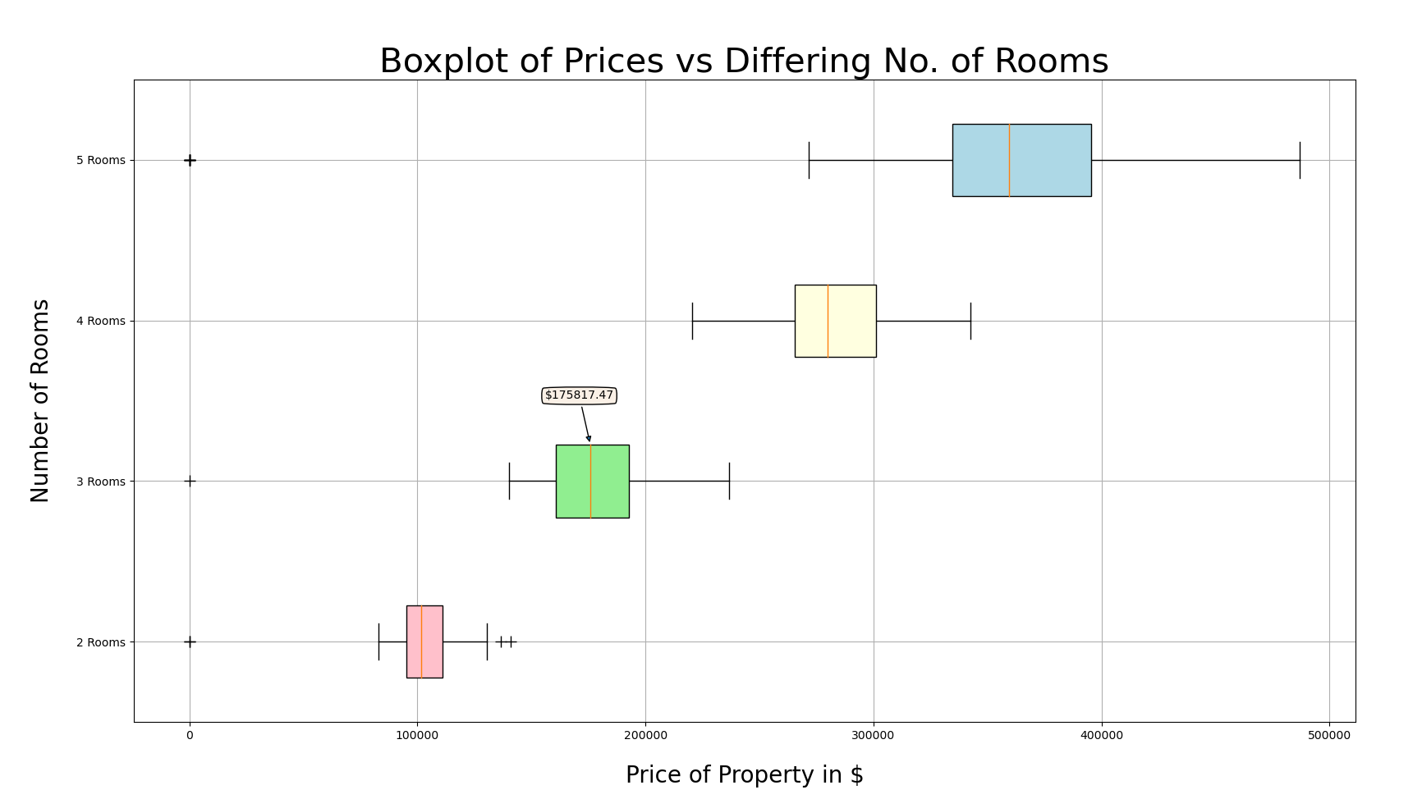
Analysis on dataset(s)

Slide 8

Explanation of insights
There is a direct correlation between an increase in rooms and the average price of the property. Over the span of 11 years, the median valuation and pricing of 2 room flats was $102,014. Furthermore, the median valuation and pricing of 5 room flats averages at $359,424, a whopping 76% increase in price.
This can be explained by the fact that an increase in the number of room of a flat greatly increases the standards of living and comfort of its occupancies, and also allows for a greater number of people to live in the property, increasing its valuation.
Additionally, there is also a direct correlation between an increase in the number of rooms and the range of the prices. The range in the prices for 2 room flats stands at an average of $46,980, whereas the range in prices for 5 room flats stand at almost 5 times more, at a steep $214,900.
This can be explained by the fact that there is a lot more variability in the customisation of 5 rooms flats, and the increased availability of 5 room flats in general. This is in contrast to the customisability and availability of 2 room flats present in Singapore, as most of them are considered studio flats.

Slide 9
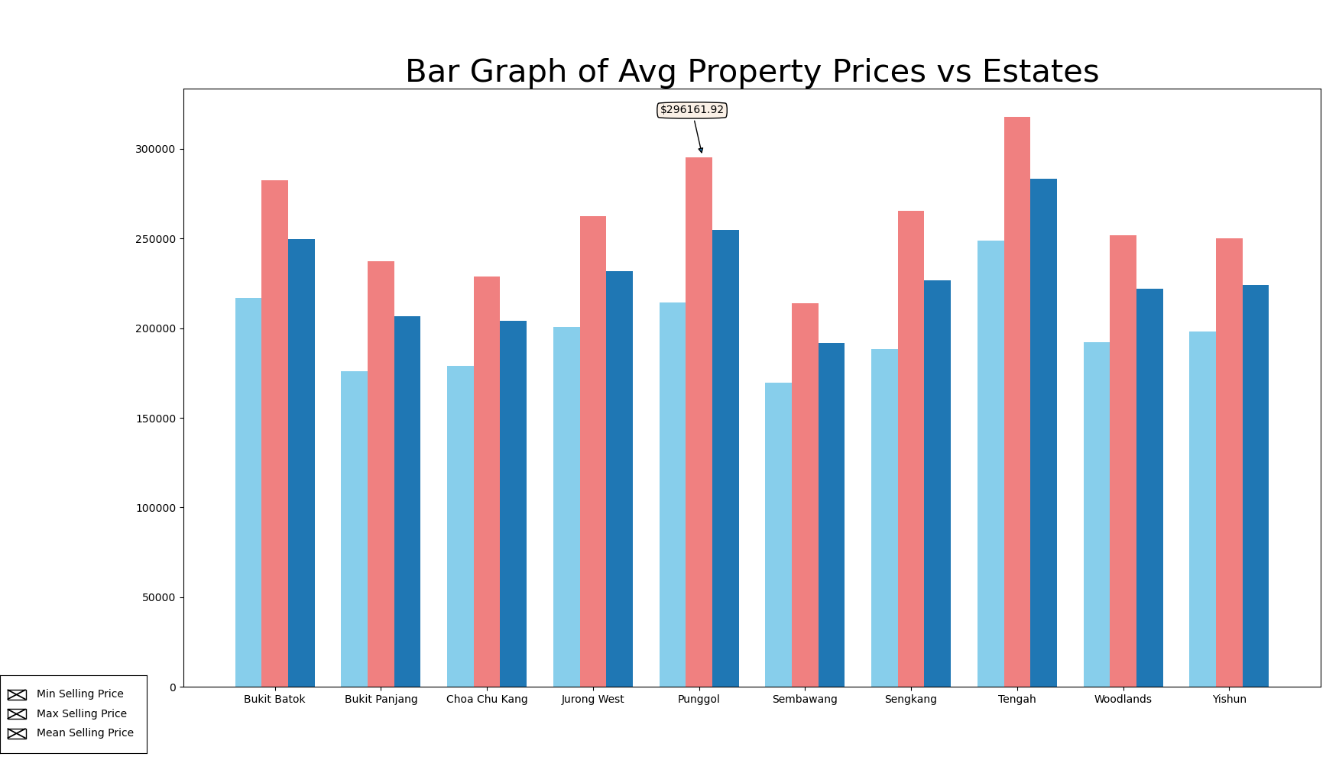
Analysis on dataset(s)

Slide 10
Explanation of insights
The region with the greatest average property price was Tengah, at $317,800. Conversely, the region with lowest average property price was Sembawang, at a mere $169,198. Additionally, the region with the greatest difference in average property prices was Punggol, at an average difference of $81,000. This suggests that the property prices in Punggol are not consistent and/or stable.
This can be explained by the region in which the properties are located in. With Tengah being in the central region, this means that the distance from the Central Business District (CBD) is a lot lower, allowing for ease of commute between work and popular places of interest. This in turn drives the prices up, to cope with increased demand
Moreover, with Sembawang being located in the northern region of Singapore where property prices are generally cheaper, this also accounts for the low average property price. This allows for properties in Sembawang to be on average, larger than their same-room counterparts in the Central Region of Singapore.

Slide 11
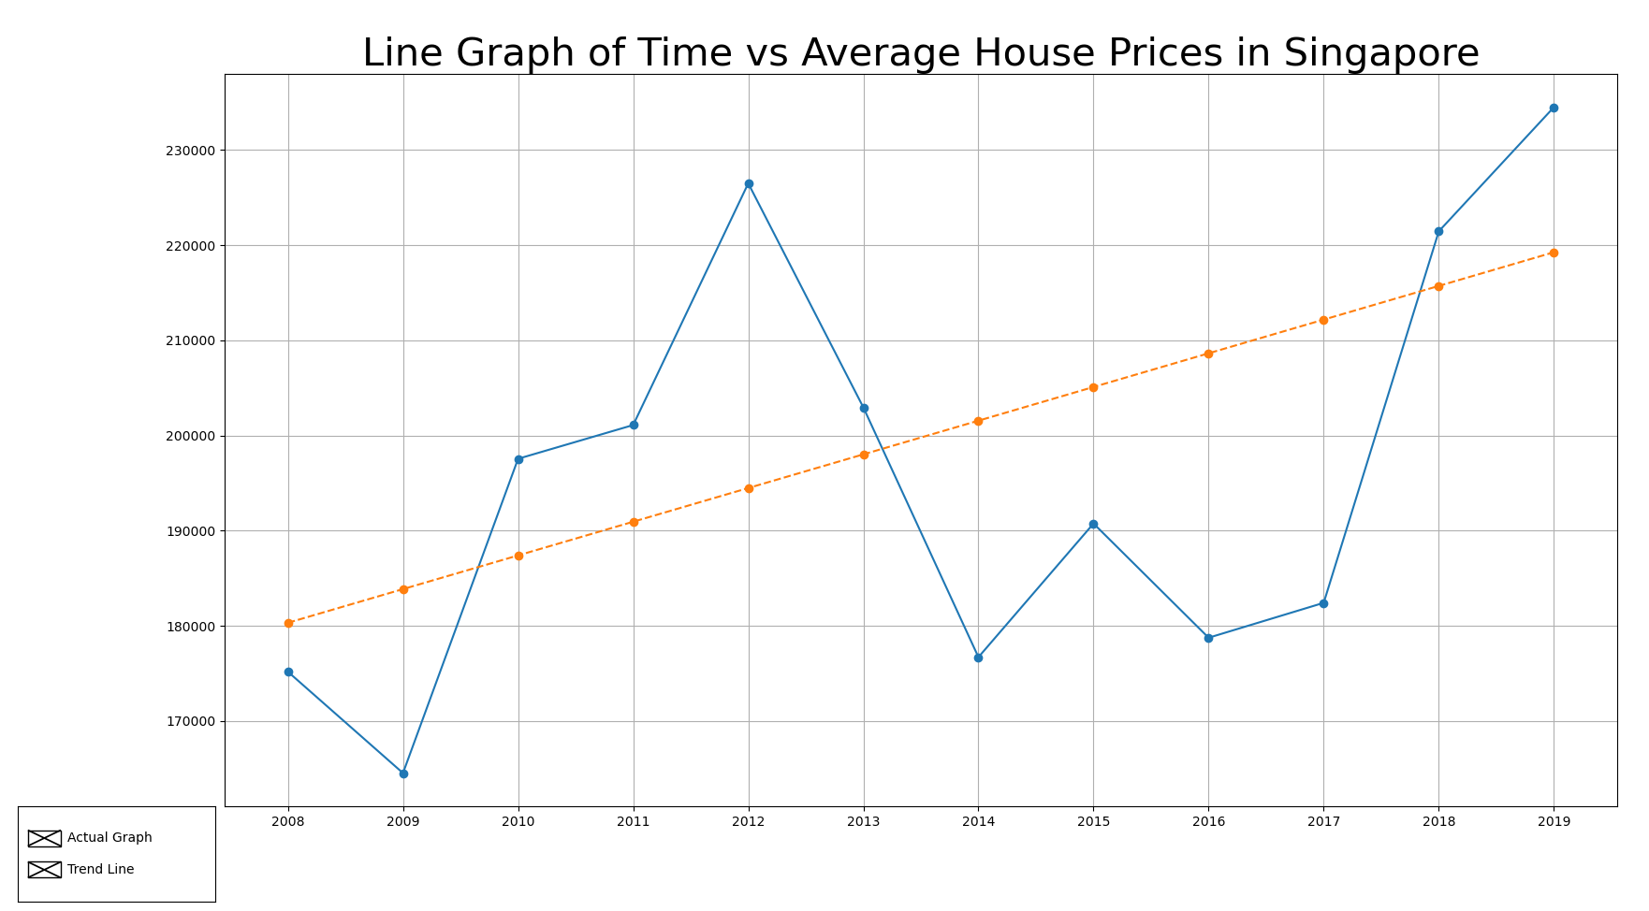
Analysis on dataset(s)

Slide 12
Explanation of insights
From 2008 to 2019, we can observe an upward trend in the average of house valuations in Singapore. This can be accounted for by a multitude of factors:
Increase in population, driving demand for number of properties in Singapore and thus increasing prices
Greater expendable income, allowing for greater flexibility on expenditure of property and respective customisations
Decreasing land space and landsize in Singapore, reducing supply of property. This works in tandem with point (1), and they form the law of supply and demand, further increasing property prices.
Greater increase in availability of bank loans, further encouraging the financialisation of the housing market.
Increase of asset price bubbles in correlation with greater unemployment rates increase the possibility of the tendency for micro-financial crises

Slide 13
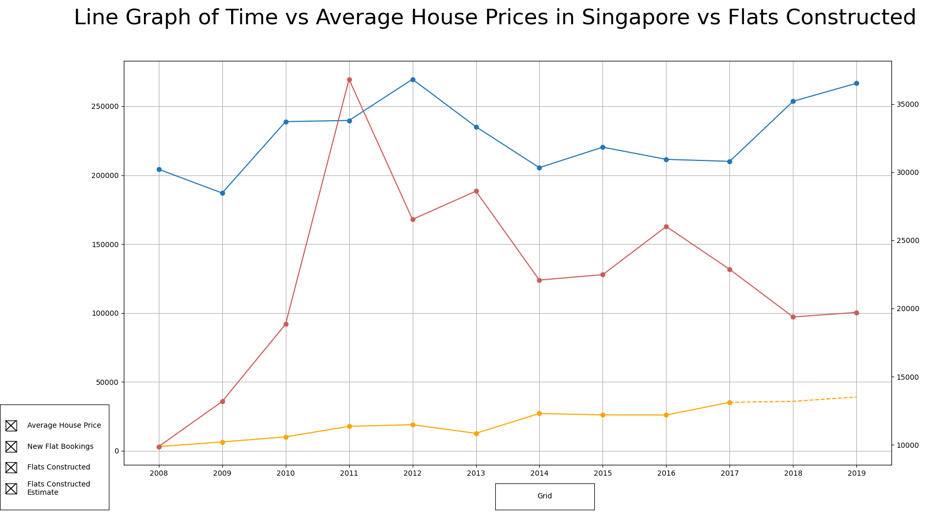
Analysis on dataset(s)

Slide 14
Explanation of insights
We can observe and increase in the number of flat bookings in Singapore. This suggests that the demand of houses in Singapore has increased. As explained in the previous slide, when the demand of houses in Singapore increases, the price also increases. This can be seen in the blue graph. This shows the direct and positive correlation between demand and price.
However, we can also observe that, with an increase of house pricing from 2017 to 2019, the number of flat bookings decreased. This means that the house pricing has exceeded the social valuation and consumer surplus, and resulted in a decrease of flat bookings.
Additionally, the side effects of point (1) mean that there in an increase in the number of flats constructed, as seen in the yellow line, where a slow and steady growth in the number of houses in Singapore can be observed

Slide 15
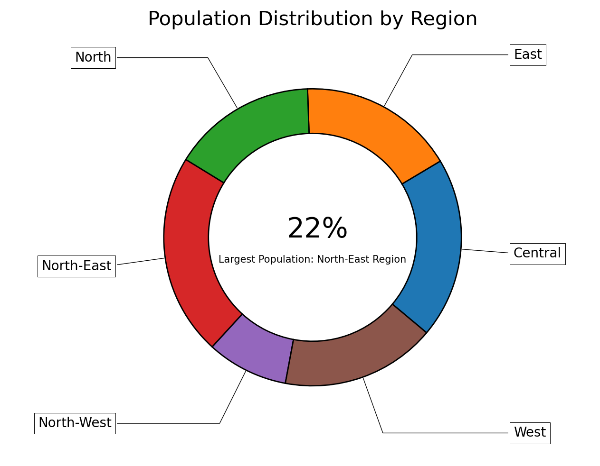
Analysis on dataset(s)

Slide 16
Explanation of insights
This suggests that consumers prefer the north eastern region of Singapore, and since the population of consumers in the Central region is greater than that of the North Western region, this suggests that consumers are willing to pay greater amounts of money to ensure their preference in region,
This claim is further backed up by the fact that the North-Western region of Singapore has lesser to offer than any other region within Singapore. As a direct comparison to the North Eastern region, the North Eastern region has facilities such as IKEA and Courts megastores, Changi Airport and Jewel and many more expensive facilities. This can mean the difference in house prices as the availability of multi-faceted and integrated facilities play a key role in the differentiation of house prices and region selection for potential buyers.
Additionally, this claim is also valid with the Northern region of Singapore, where average house prices ranked the lowest, as mentioned in the previous slides. The population in the Northern regions can rival that of those in the Central region, even though property prices for each region are on both ends of the spectrum. This is due the availability of the Causeway and international travel between Singapore and Malaysia. This further backs up the claim of lack of facilities and a poor geographical location causing lower population in the North Eastern Region

Slide 17
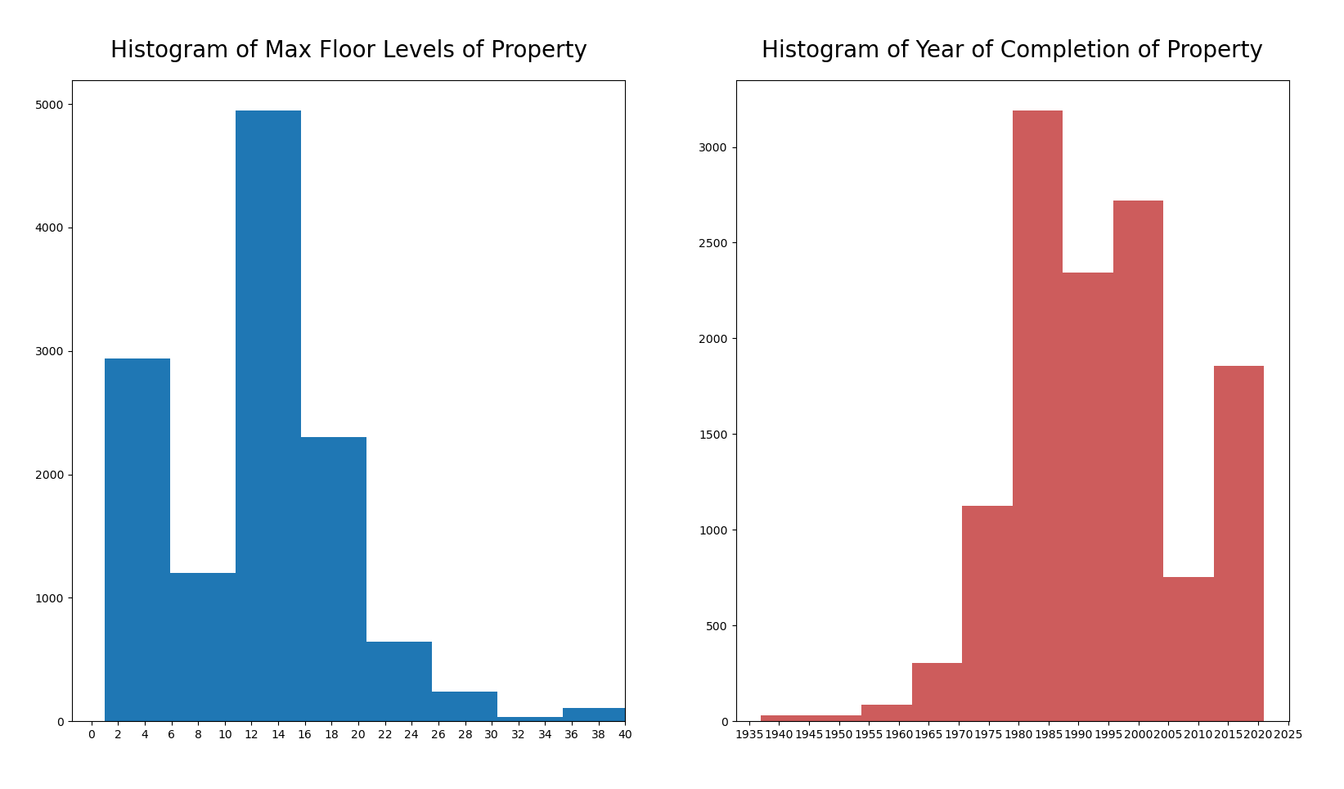
Analysis on dataset(s)

Slide 18
Explanation of insights
As we can see, there is a trend, showing the distribution of the number of maximum levels of properties. We can see that properties in Singapore average at about a maximum of 12-14 stories. This is due to the fact that properties with lower levels are more expensive due to the fact that there is a limited land space available in Singapore. This is countered by building upwards instead of outwards, which then increases the max levels of the property.
However, properties with 30 stories or higher are few and far between, as the Singapore Improvement Trust (setup in 1927) and the Housing Development Board lacked the resources back in 1960 to confidently construct properties with 30 or more stories. This was during the initial phase of property planning in Singapore, after its departure from Malaysia. Restrictions and a lack of availability of required resources and technology meant that houses with 12-14 stories were Singapore’s best bet at constructing safe and structurally safe property for its people.
This can be seen in the red histogram, where there was a surge in the number of property built from 1965 to 2000, after Singapore’s independence and its infant ages. The trend began to slow down due to increase in property prices and a slow but sure decline in the availability of property space to construct public housing.
Notes:
HOUSING A NATION, BUILDING A CITY (psd.gov.sg)
gov.sg | Evolution of public housing in Singapore (www.gov.sg)

Slide 19
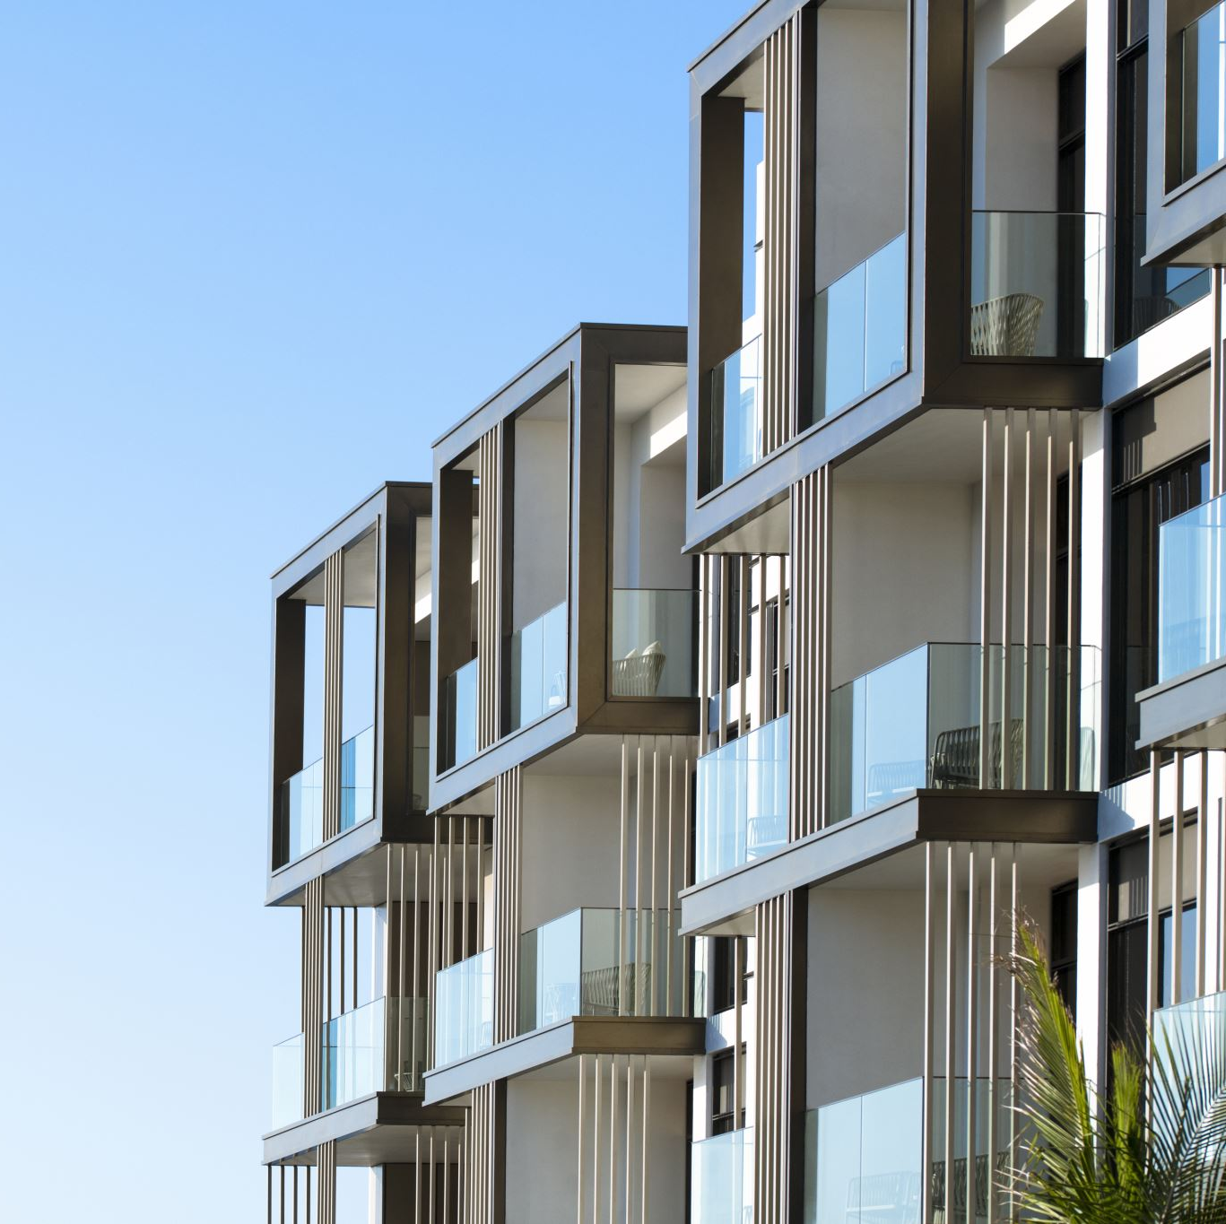
Conclusion of insights
For housing properties within Singapore, consumers preferred:
- the North-Eastern and Central Region
to pay more for a preference in Region Choice
For housing properties within Singapore, prices were:
- more expensive the more rooms there were in the property
more expensive in the Central region and cheapest in the Northern Region
more fluid and unstable in Central regions and Eastern Regions due to greater flexibility in customisation options e.g. new estates (Punggol)
Housing properties within Singapore:
- were more expensive when it offered more comfort, resources and convenience
were more commonly found with 12-14 stories, and were built generally between 1965-2000
appreciated with time, due to a limited number of landsize available

Slide 20
credits
HOUSING A NATION, BUILDING A CITY (psd.gov.sg) [Accessed 2 Jan 2022]
gov.sg | Evolution of public housing in Singapore (www.gov.sg) [Accessed 2 Jan 2022]

